Slide 1

Does virtual learning work for everyone?

Slide 2

Story Telling
A data analyst who works at a university is tasked to perform analysis to review students’ performance on Virtual Learning Environment (VLE).
Gain insights into how well is the implementation of the virtual learning platform.
For Management to make business decision whether to offer more online courses and to have their resources allocated more efficiently.
Dataset: https://www.kaggle.com/rocki37/open-university-learning-analytics-dataset

Slide 3
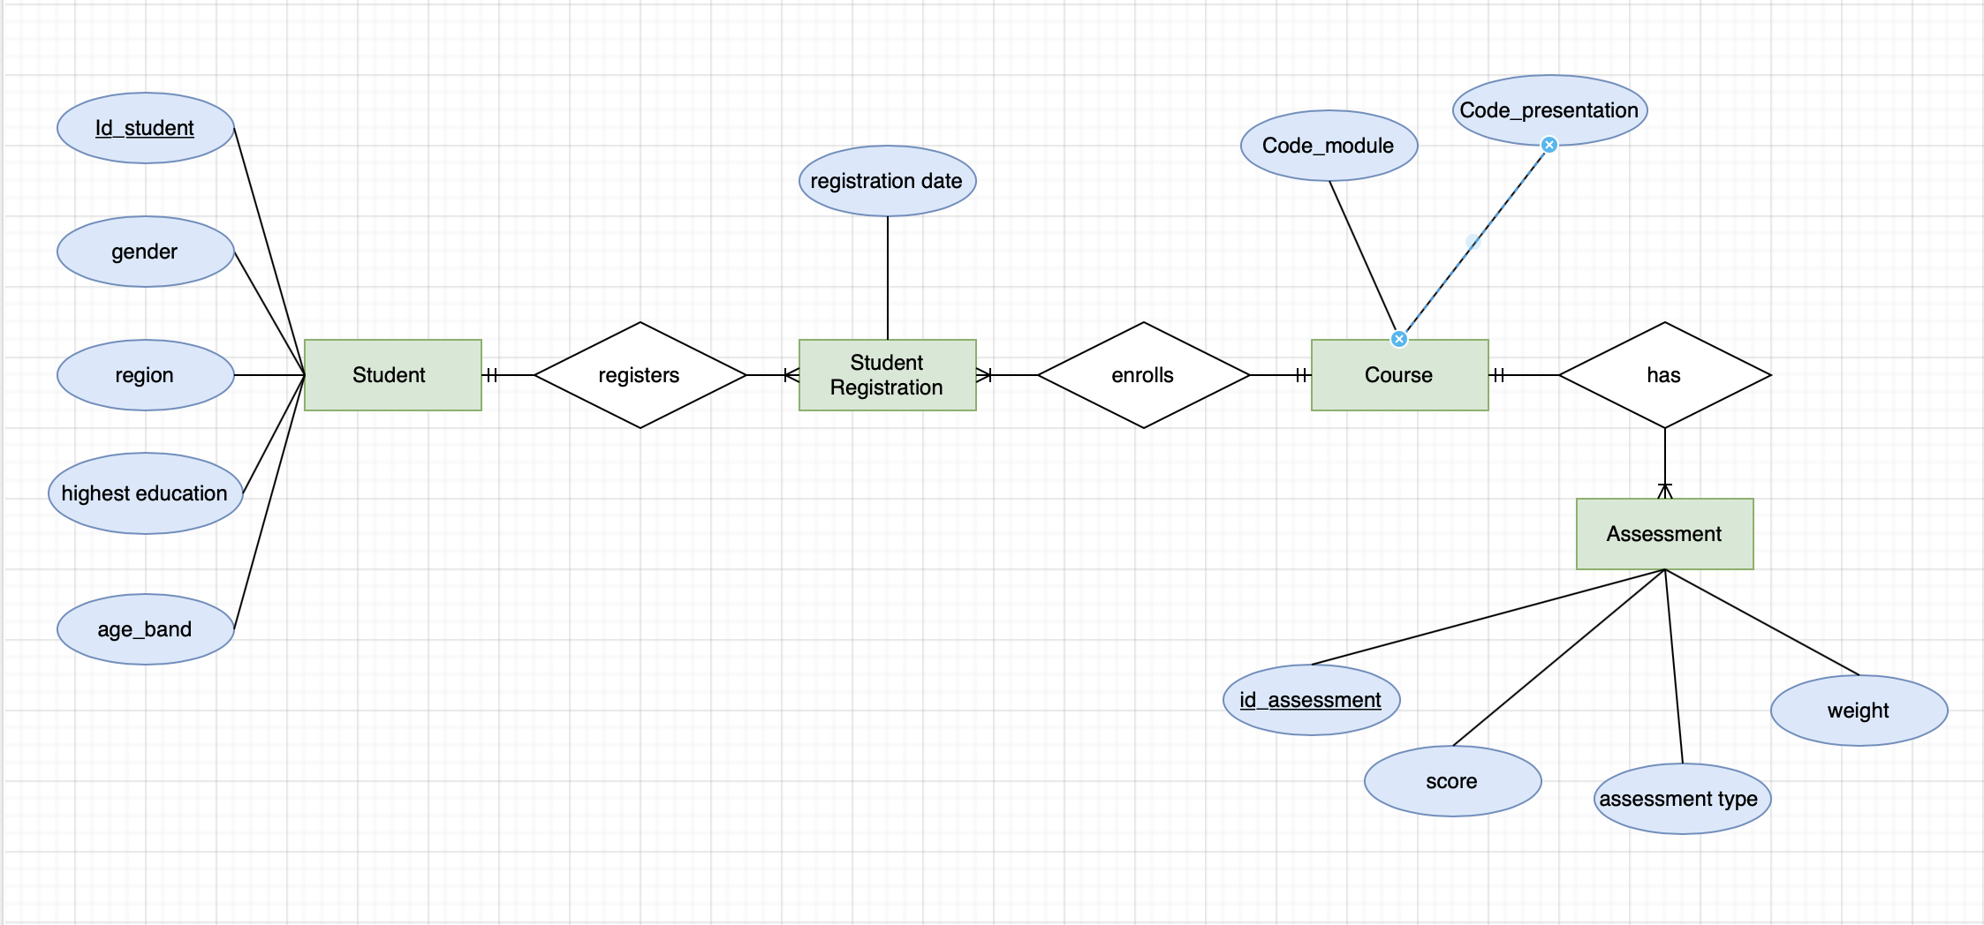
Entity Relation Diagram (ERD)
The dataset contains data about students' characteristics, registration of courses and their assessment results for 7 available courses.
Student has the attributes of ID, gender, region and so on.
A student registers for a course through registration (to cater for Many to many situation).
Course has the element of module code and presentation code.
Assessment associated with the courses has the element of ID info, assessment type, score and etc.

Slide 4
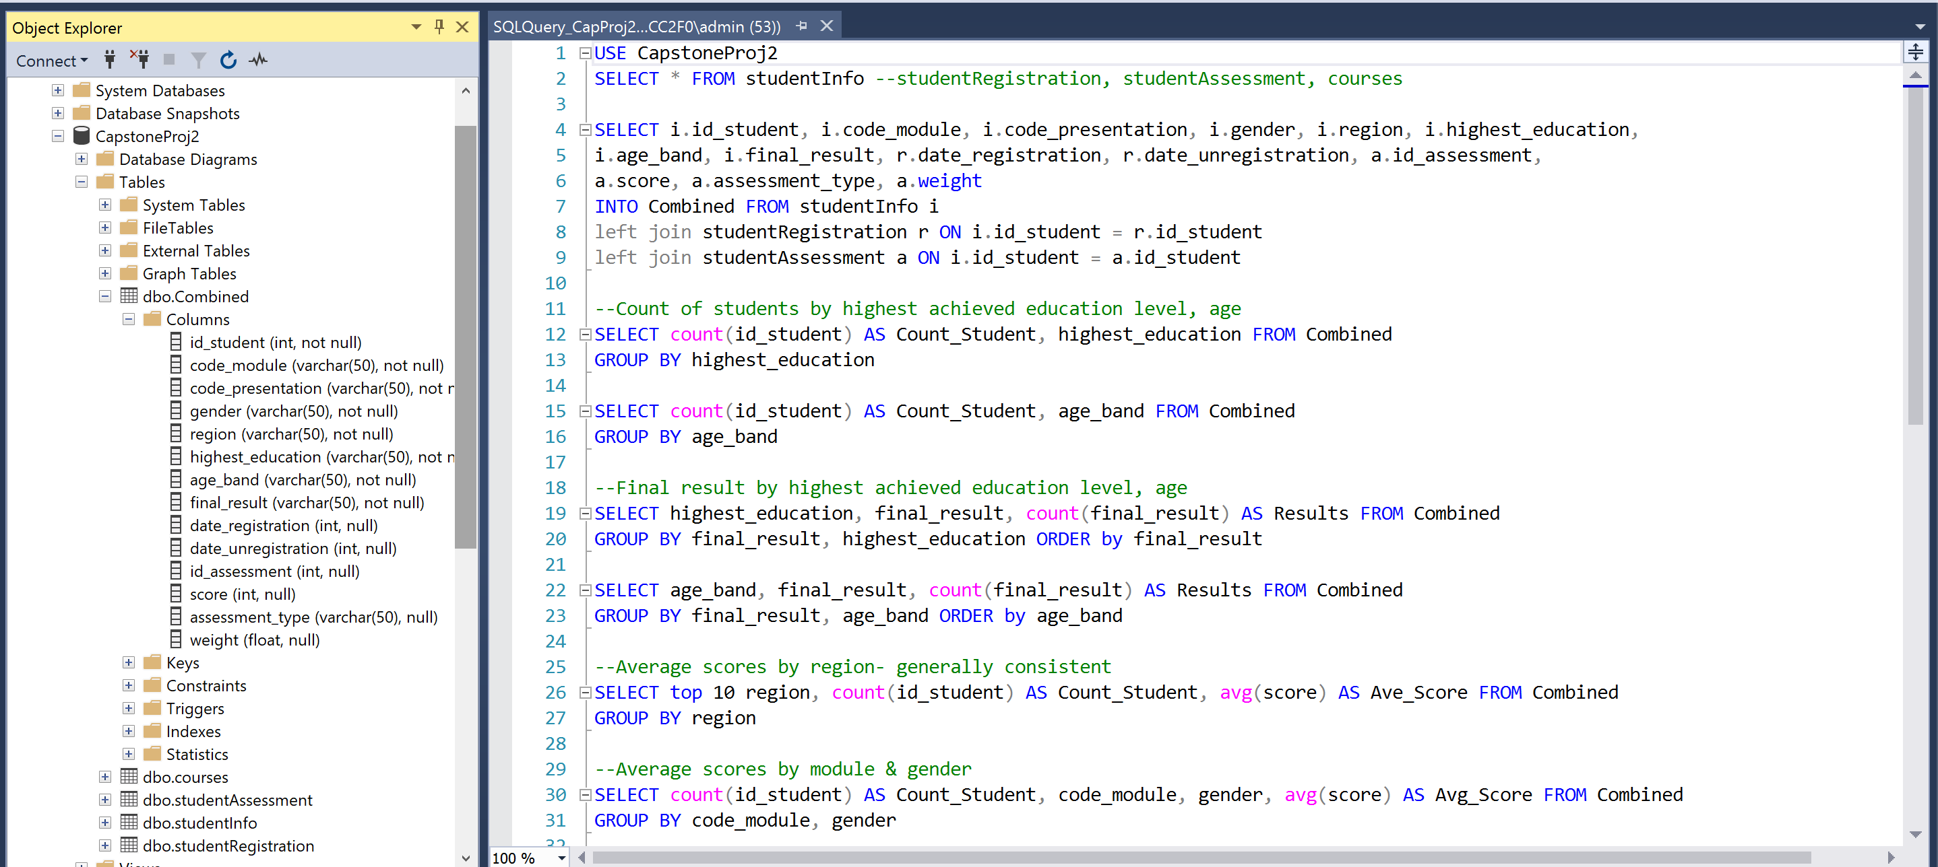
Data Preparation & Analysis
Data cleaning and data normalization with SQL:
Combining necessary tables with Left Join.
To explore the influential variables by grouping and order by different variables (age band, average scores, final outcomes, student counts, module, gender, top 10 region etc).

Slide 5
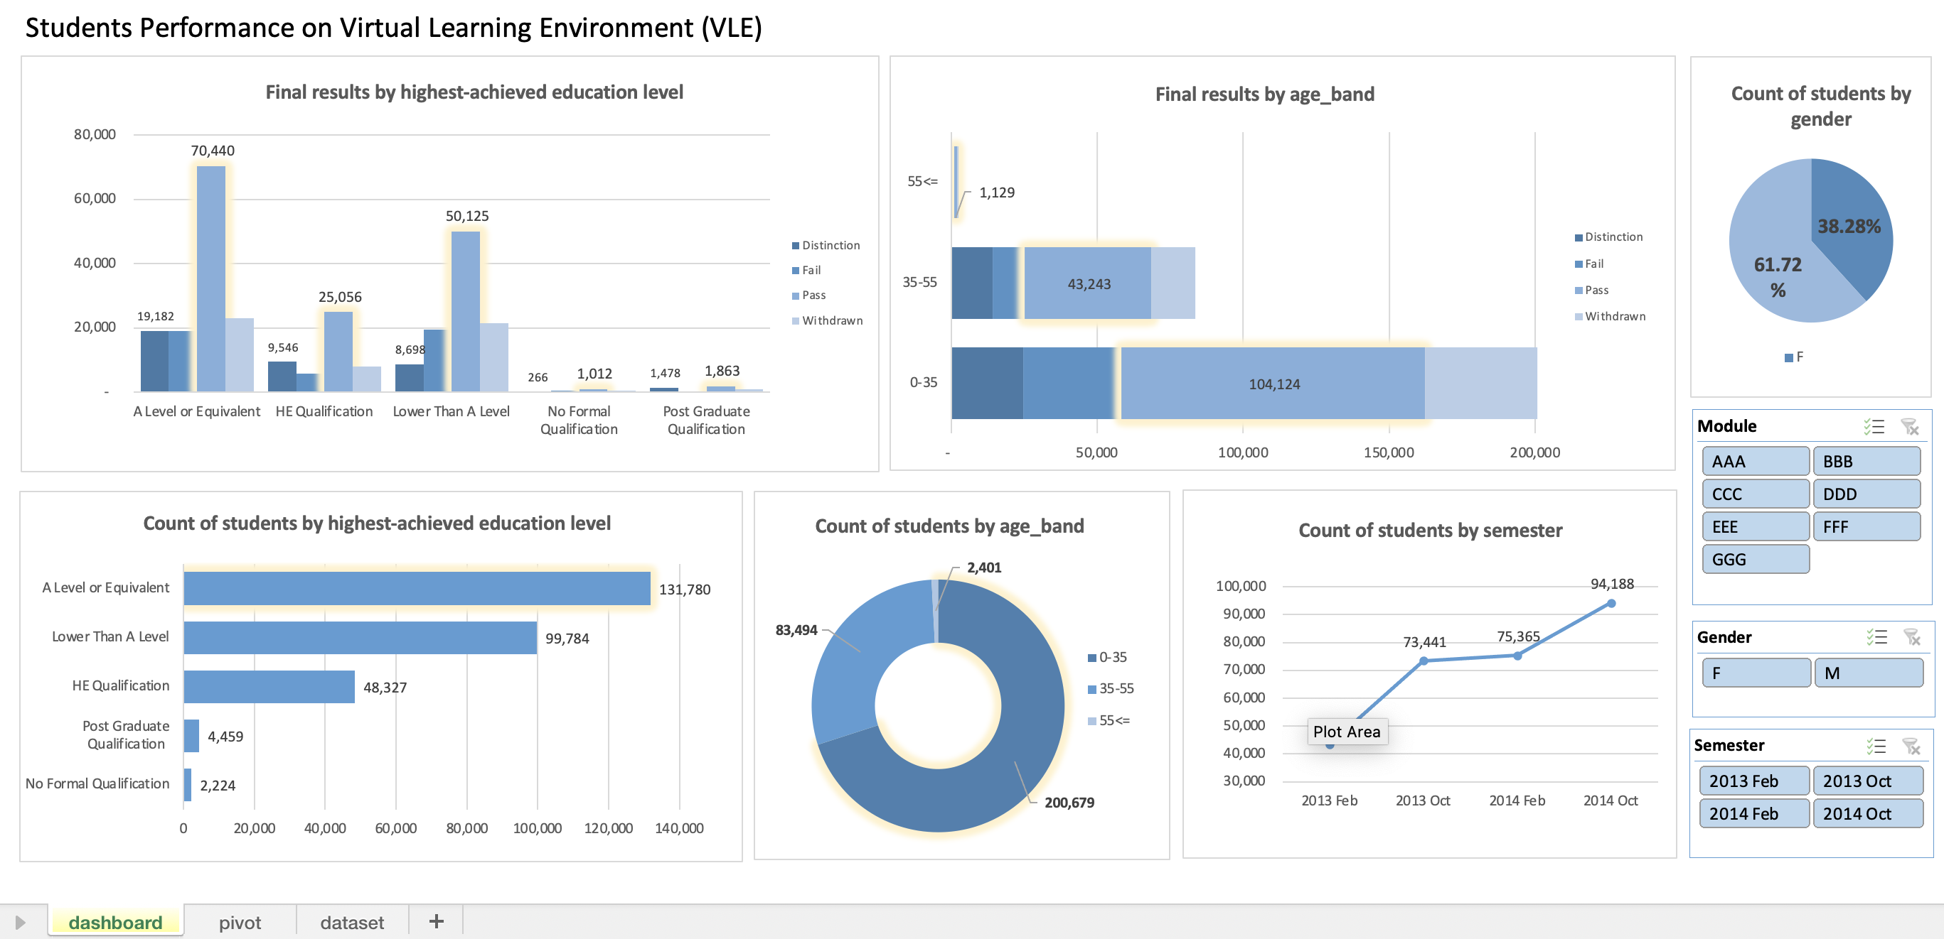
Interactive Excel Dashboard
Insights: Influential features determining students' performance largely depends on:
1. The variation of education background- categories 'A level and eq' and 'Lower than A level' contributes the highest count of registered students and highest count of pass/ distinction grades.
2. Age group- the distribution is right-skewed, most of the courses are signed up by younger generation, mainly below the age of 35.
3. Through filtering we could tell that the most popular courses are module C, D and F.

Slide 6

Recommendations
With the increasing trend of number of students registered over the years, it seems reasonable to strategically offer more related courses targeting the specific audience:
The younger generations, specifically the group with education background of A level and below.
Alternatively courses similar to module C, D and F could be increased to cater for wider population.
In conclusion it would be feasible to promote more online courses so as to improve students’ digital competence and adaptability (also in line with government initiative of digitalization), and to promote an effective and independent learning environment.

Slide 7

Thank you!

